Slide 1

Presented By: Team Members: 1. Mukkara DivyaSree-24251A05M9 2. Komatireddy Keerthana-24241A05L9 3. P. Sai Priya Reddy-24251A05R3
G. NARAYANAMMA INSTITUTE OF TECHNOLOGY & SCIENCE
AUTONOMOUS(For Women)
Shaikpet, Hyderabad ,Telangana
DEPARTMENT OF COMPUTER SCIENCE AND ENGINEERING
Lightweight Anomaly Detection for Wearable Data Using Autoencoders
Batch No:D9
Guide: Dr. A. Sarada
Professor & Head

Slide 2
Table of Contents
Introduction
Literature Survey
Existing system
Problem Statement
Proposed system
Objectives
Methodology
Technologies
Results

Slide 3
Introduction
Background of Topic
Wearable devices such as smartwatches and fitness trackers enable continuous monitoring of physiological and activity-based data including heart rate, sleep patterns, and motion signals. These devices generate large volumes of time-series health data.
Domain Overview
The project belongs to the domain of:
Digital Health Analytics
Wearable Computing
Lightweight Deep Learning
Real-Time Anomaly Detection
Who Faces the Problem
IT employees and corporate professionals
Individuals with sedentary lifestyles
Employees exposed to stress and irregular sleep cycles
Why It Must Be Solved
Sedentary behavior increases risk of cardiovascular diseases
Circadian rhythm disruption leads to stress and burnout
Existing fitness apps do not intelligently detect abnormal patterns
Importance of the Problem
Early detection prevents long-term health complications
Supports corporate wellness programs
Enables proactive health monitoring
Need for the System
A lightweight, real-time anomaly detection system is required to:
Identify abnormal physiological patterns
Detect circadian rhythm disruptions
Operate efficiently on resource-constrained wearable devices

Slide 4
Literature Survey
S.No | Tittle of the Journal with Published Year | Authors | Method | Outcomes | Limitations
1 | Deep Learning for Wearable Health Monitoring (2023) | Zhang et al. | LSTM + Autoencoder | Improved stress detection | High computational cost
2 | Real-Time Anomaly Detection in IoT Healthcare (2022) | Kumar & Singh | Autoencoder-based anomaly detection | Efficient anomaly detection | Limited feature diversity
3 | Circadian Rhythm Monitoring Using Wearables (2021) | Lee et al. | Time-series analysis | Identified sleep irregularities | No deep learning integration
4 | Accelerometer-Based Sedentary Detection (2020) | Smith et al. | Threshold-based classification | Accurate sedentary time detection | Not adaptive
5 | Lightweight Deep Learning Models for Edge Devices (2019) | Chen & Wang | Compact neural networks | Low computational overhead | Reduced model complexity

Slide 5
Existing system
Current System Description
Current wearable systems provide:
Step count tracking
Heart rate monitoring
Sleep duration display
How It Works
Collects raw sensor signals
Displays summary statistics
Provides basic alerts (e.g., step goals)
Technologies Used
Embedded firmware
Basic signal processing
Rule-based threshold systems
Limitations / Challenges
No intelligent anomaly detection
No circadian disruption analysis
No personalized risk scoring
High computational cost for complex models

Slide 6
Problem statement
Wearable devices generate continuous physiological and activity data, but existing systems fail to intelligently detect subtle abnormalities in real time. Circadian rhythm disruptions and stress-related deviations often go unnoticed due to the lack of lightweight anomaly detection models suitable for wearable environments. Therefore, the problem is to develop an efficient autoencoder-based system that can learn normal patterns and identify unusual behavioral deviations from wearable data.

Slide 7
Proposed system
Solution Idea
Develop a lightweight autoencoder model that learns normal wearable health patterns and detects abnormal behavior using reconstruction error.
How It Solves the Problem
Learns normal physiological patterns
Detects unusual deviations
Identifies circadian disruptions early
Suitable for real-time wearable deployment
Key Features
Accelerometer-based sedentary detection
Stress score computation
Recovery index calculation
Lightweight deep learning model
Smartwatch-style visualization dashboard

Slide 8
Objectives
To design a system capable of processing at least 8000 wearable data records efficiently.
To develop an autoencoder model achieving reliable anomaly detection using reconstruction error.
To implement real-time evaluation with low computational overhead.
To analyze system performance using loss metrics and anomaly threshold validation.

Slide 9
Methodology
Flow Diagram
Data Collection → Data Preprocessing → Feature Engineering → Autoencoder Training → Reconstruction Error Calculation → Anomaly Detection → Dashboard Visualization → Performance Evaluation
Modules of Project
Data Collection Module
Preprocessing & Normalization Module
Feature Engineering Module
Lightweight Autoencoder Model Module
Anomaly Detection Module
Visualization Dashboard Module
Short Explanation
Collect wearable data (accelerometer, HR, sleep, steps)
Normalize and clean signals
Extract derived features (sedentary minutes, stress score)
Train autoencoder on normal data
Detect anomalies using reconstruction error
Display results in dashboard

Slide 10
Technologies
Python
Pandas
NumPy
Scikit-learn
TensorFlow / Keras
Plotly
Streamlit
VS code

Slide 11
Results
Output Screenshots
Autoencoder training loss graph
Reconstruction error distribution
Smartwatch-style dashboard
Stress & Sedentary score visualization
Performance Metrics
Reconstruction Loss (MSE)
Anomaly Detection Rate
Computational Efficiency
Model Training Time
Observations
Lightweight model performs efficiently
Reconstruction error successfully identifies abnormal patterns
Suitable for real-time wearable analytics

Slide 12
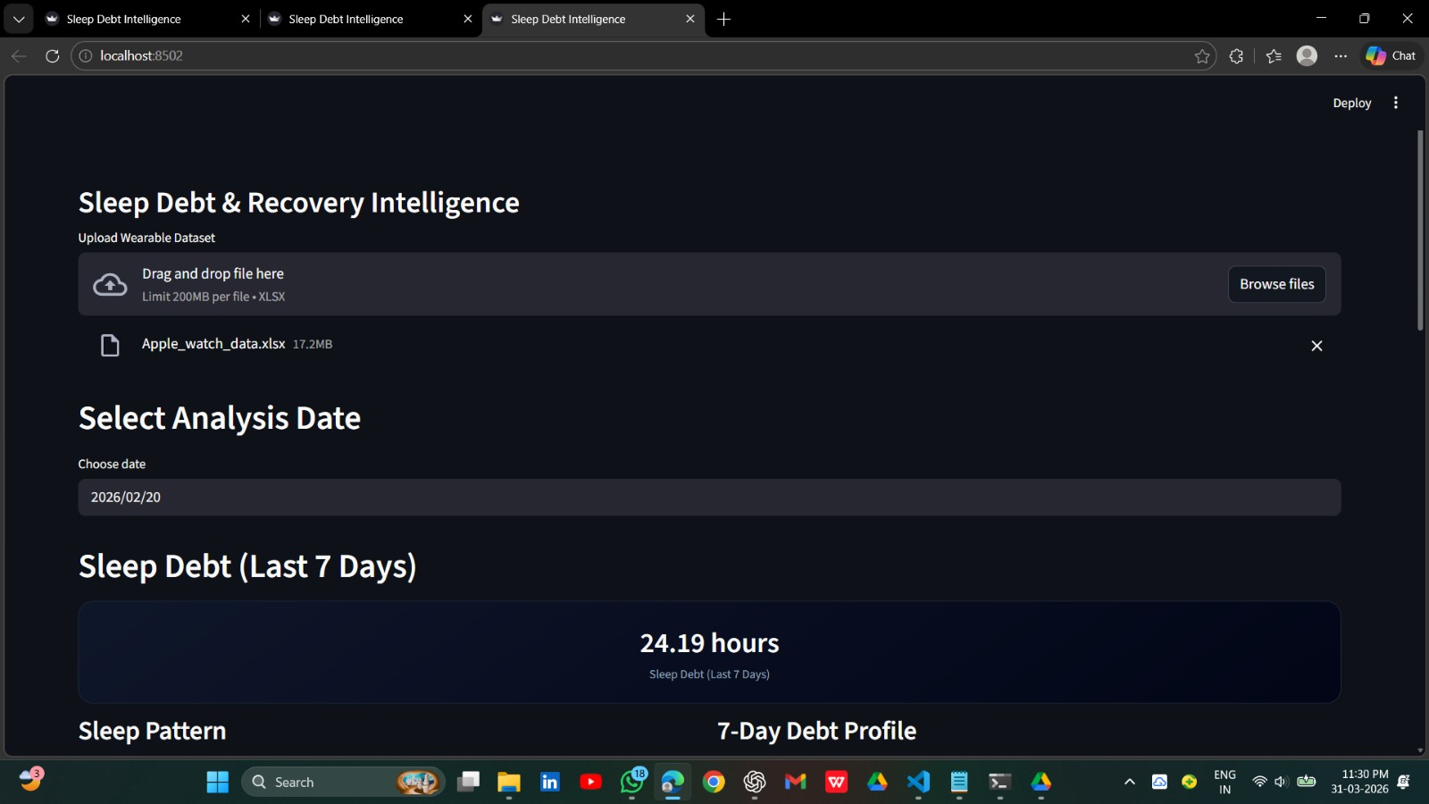
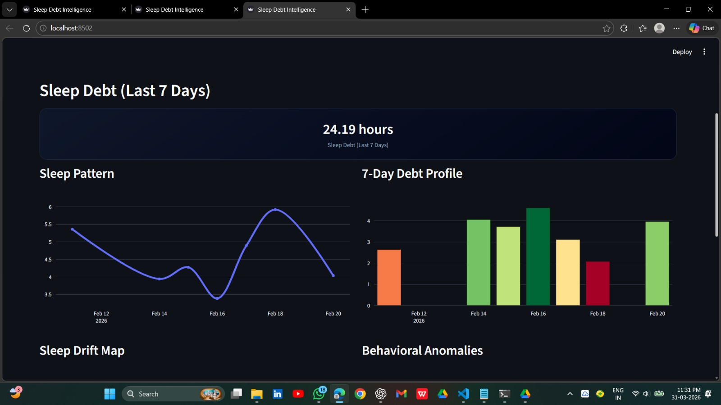
Displays the main dashboard where users upload wearable data and select an analysis date.
Provides a quick summary of total sleep debt over the last 7 days for instant insights .
Displays detailed sleep patterns alongside a 7-day sleep debt distribution.
Helps users identify which days contributed most to overall sleep debt.

Slide 13
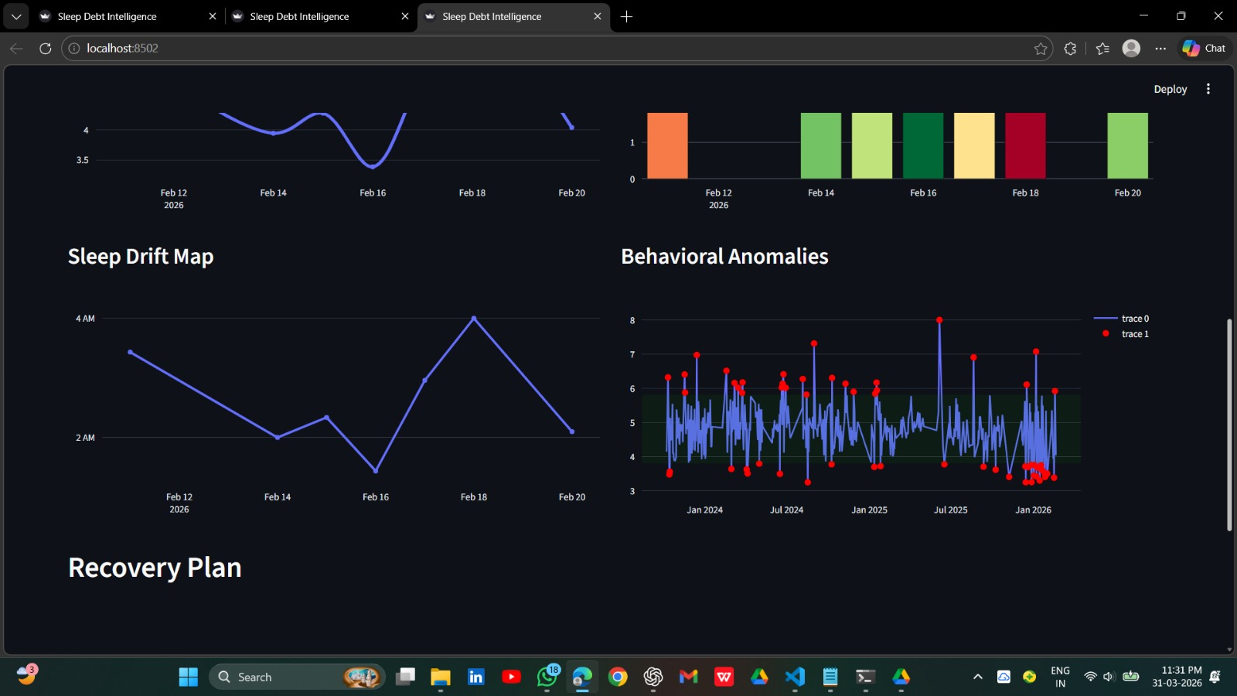
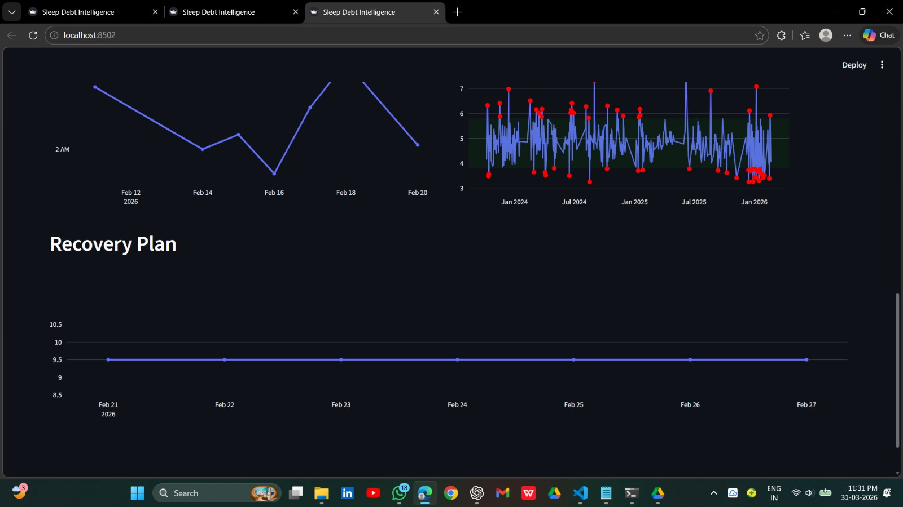
Illustrates sleep drift patterns indicating irregular sleep timing behavior.
Detects anomalies using data points to identify unusual sleep disturbances.
Visualizes sleep trends and highlights fluctuations across multiple days.
Provides a recovery plan to help users improve sleep consistency and reduce debt.

Slide 14
References
Goodfellow I., Bengio Y., Courville A., Deep Learning, First Edition, MIT Press, 2016
Aggarwal C. C., Neural Networks and Deep Learning, Springer, 2018
Bishop C. M., Pattern Recognition and Machine Learning, Springer, 2006
Szeliski R., Computer Vision: Algorithms and Applications, Springer, 2011

Slide 15
Thank you

